Slide 1


JAVA SE
(CORE JAVA)
LECTURE-36

Slide 2

Today’s Agenda
• Using JRadio Button.
Handling JRadioButton Event.
JComboBox component.
Methods of JComboBox.
Handling JComboBox Event.

Slide 3
Using JRadio Button
Radio buttons in java are GUI controls which are use to accept a single option amongs multiple choices from the user ,i.e. mutually exclusive by nature.
text: For setting the text on JButton.
icon: For setting image on JButton.
font: For changing font of the JButton.
background: For changing the background color of JButton.
foreground: For changing the font color of JButton.
selected: For changing the initial state of JRadioButton to selected or deselected.
buttongroup: For making radio buttons manually exclusive.

Slide 4
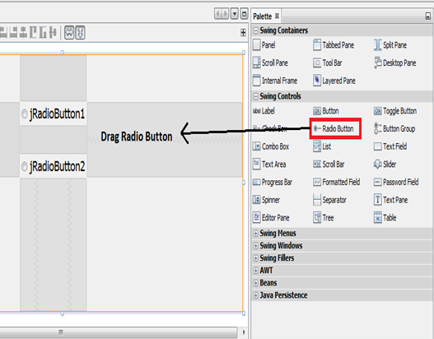
Practical Implementation Of ButtonGroup
In order to create grouped JRadioButtons with ButtonGroup one should follow these steps:
1. Drag and drop a panel onto your form. Then locate the Radio Button control in the NetBeans palette. Drag a Radio button onto your new palette. It should look like this:

Slide 5
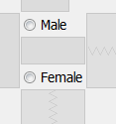
Practical Implementation Of ButtonGroup
2. The default text for the first radio button is jRadioButton1. We'll use our radio buttons to allow a user, so change the text of your radio button to Male.
3. Add one more radio button to the panel. Change the text to Female:

Slide 6
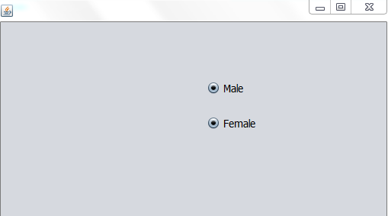
Practical Implementation Of ButtonGroup
4. There is, however, a problem with the radio buttons you've just added. To see what the problem is, run your programme again. Now select one of the radio button. Try selecting another radio button and you'll find that you can indeed select more than one at the same time:

Slide 7
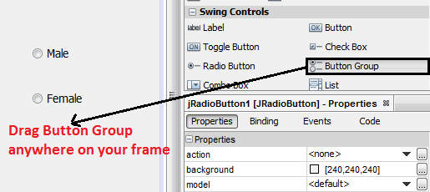
Practical Implementation Of ButtonGroup
5. With our radio buttons, though, we only want the user to select one option. To solve the problem, Java lets you to create something called a ButtonGroup. As its name suggests, this allows you to group buttons under one name. You can then add radio buttons to the group.

Slide 8
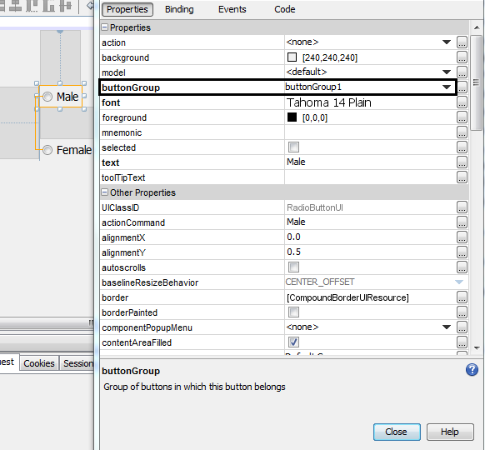
Practical Implementation Of ButtonGroup
6. Then select the Male radio button make a right click and go to the Properties window on the bottom right corner. There you will see buttonGroup property then choose the element name as buttongroup1. Now Male becomes a part of buttonGroup1.

Slide 9
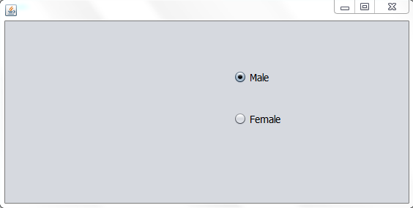
Practical Implementation Of ButtonGroup
7. Do the same process for Female radio button also. Put the Female radio button in the same buttonGroup1. Then Male and Female radio buttons automatically becomes mutually exclusive. At a time only one is on.

Slide 10
By default "JRadioButton" objects are not mutually exclusive i.e. when we select the next radio button the previously selected radio button doesn't get deselected. To change this behaviour we need to put "JRadioButton" objects into a common group. This group is formed using a "ButtonGroup" object. "ButtonGroup" is a class and all the "JRadioButton" objects added to the same"ButtonGroup" become "Mutually Exclusive".
To add "JRadioButton" to "ButtonGroup" we have to do two things:
Drag a ButtonGroup object on frame.
Set the Button Group property of JRadioButton to the ButtonGroup object .
Making "JRadioButton" Objects Mutually Exclusive

Slide 11
Events Fired In JRadioButton:
A "JRadioButton" object fires the same event as a "JButton" object i.e. ActionEvent so we have to override the method "actionPerformed( )" and event handling is done same as we do in "JButton“.
Handling JRadioButton Event

Slide 12
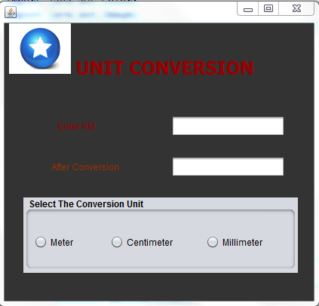
Example
Develop an application containing two text field and three radio buttons titled Meter, Centimeter and Killometer. As the user selects these radio buttons apply the required output on the another text field.

Slide 13
Example
private void myActionPerformed(java.awt.event.ActionEvent evt) {
String kmstr = txtKm.getText();
try
{
int km=Integer.parseInt(kmstr);
String result;
if(evt.getSource()==jrMeter)
{
int meter=km*1000;
result=meter+" meters";
}
else if(evt.getSource()==jrCentimeter)
{
int cm=km*100000;
result=cm+" centimeters";
}

Slide 14
else
{
int mm=km*1000000;
result=mm+" millimeters";
}
txtResult.setText(result);
}
catch(NumberFormatException ex)
{
JOptionPane.showMessageDialog(null,"Please intput digits only","Conversion Error!",JOptionPane.ERROR_MESSAGE);
txtKm.setText("");
txtKm.requestFocus();
}
}
Example

Slide 15
The JComboBox Component
ComboBoxes are dropdown list which display a list of choices to the user and allow him to select one element at a time.
Properties Of "JComboBox"
1. model:- For setting items to be displayed in the JComboBox
2. maximumrowcount:- For settings no of items to be displayed by default in the JComboBox

Slide 16
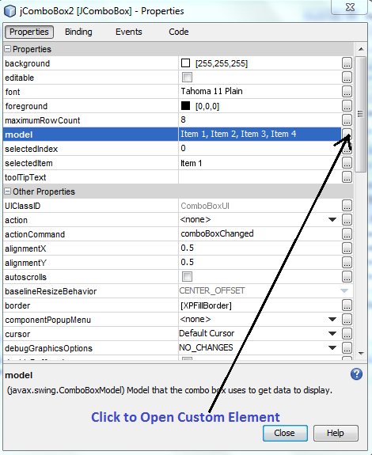
How To Add Elements At Design Time In ComboBox
Drag and drop Combo Box into your Frame.
Then select the Combo Box make a right click and go to the Properties window on the bottom right corner. There you will see model property then click to open custom editor.

Slide 17
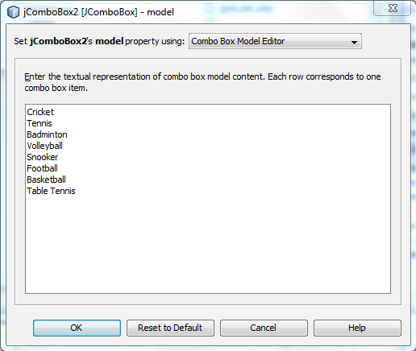
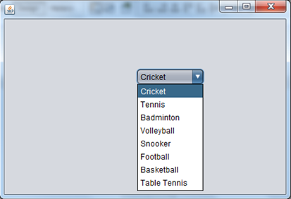
Adding Element At Design Time In Combobox
3. Now enter the textual representation of combo box model content.
4. Now run the code. It will look
like this:

Slide 18
Methods of JComboBox
Methods:
1. public void addItem(Object)
2. public void insertItemAt(Object,int)
3. public int getItemCount( )
4. public int getSelectedIndex( )
5. public void removeItemAt(int)
6. public void removeAllItems()
7. public Object getSelectedItem( )
8. public void setMaximumRowCount(int)

Slide 19
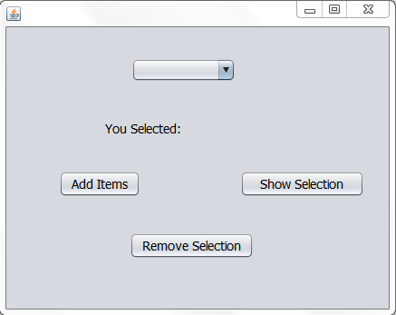
Handling JComboBox Event
Events Fired In JComboBox:
A "JComboBox" object fires the same event as a "JButton" object i.e. ActionEvent so we have to override the method "actionPerformed( )" and event handling is done same as we do in "JButton“
Develop an application have the behavior as shown below:

Slide 20
Example Of ComboBox
Code:-
private void jButton1ActionPerformed(java.awt.event.ActionEvent evt)
{
String[] arr={"January","February","March","April","May","June","July","August"};
for(String s:arr)
{
jComboBox1.addItem(s);
}
}
private void jButton2ActionPerformed(java.awt.event.ActionEvent evt) {
try
{
String str=jComboBox1.getSelectedItem().toString();
jLabel1.setText("You Selected:"+str);
}
catch(NullPointerException e)
{
JOptionPane.showMessageDialog(null, "Please make a selection first");
}
}

Slide 21
Example Of ComboBox
private void jButton3ActionPerformed(java.awt.event.ActionEvent evt) {
try
{
int index=jComboBox1.getSelectedIndex();
jComboBox1.removeItemAt(index);
JOptionPane.showMessageDialog(null, "Item Removed!");
}
catch(ArrayIndexOutOfBoundsException e)
{
JOptionPane.showMessageDialog(null, "Please select an item first");
}
}

Slide 22

End Of Lecture 36
For any queries mail us @: scalive4u@gmail.com
Call us @ : 0755-4271659, 7879165533
Agenda for Next Lecture:
1. Using JList Component.

